Slide 1
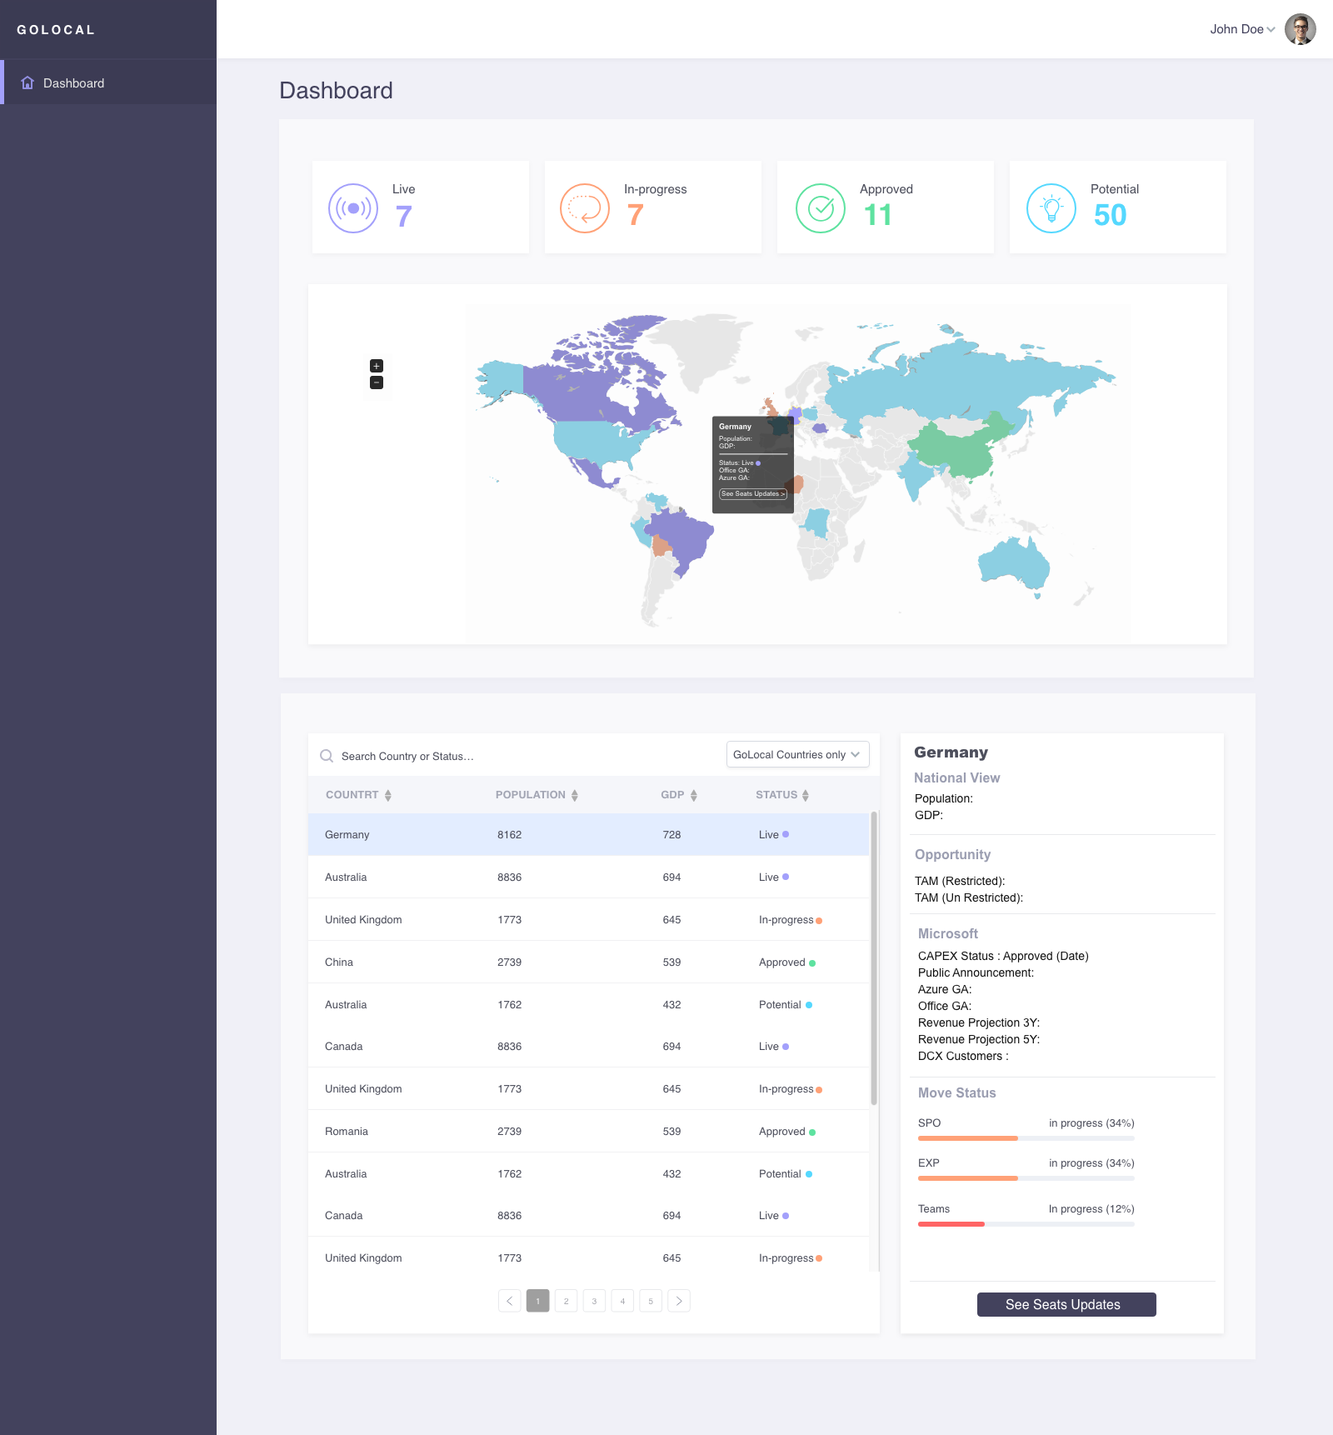
Card (React and Material-Ui)(MIT)
https://github.com/facebook/react
https://github.com/mui-org/material-ui
Header (React and material-ui) (MIT)
https://github.com/facebook/react
https://github.com/mui-org/material-ui
Map (React and react-jvectormap)(MIT)
https://github.com/facebook/react
https://github.com/kadoshms/react-jvectormap
Table (React and material-ui)(MIT)
https://github.com/facebook/react
https://github.com/mui-org/material-ui
Info Card (React and material-ui)(MIT)
https://github.com/facebook/react
https://github.com/mui-org/material-ui
Button (React & Material-ui )(MIT)
https://github.com/facebook/react
https://github.com/mui-org/material-ui
Progress (React and material-ui)(MIT)
https://github.com/facebook/react
https://github.com/mui-org/material-ui

Slide 2
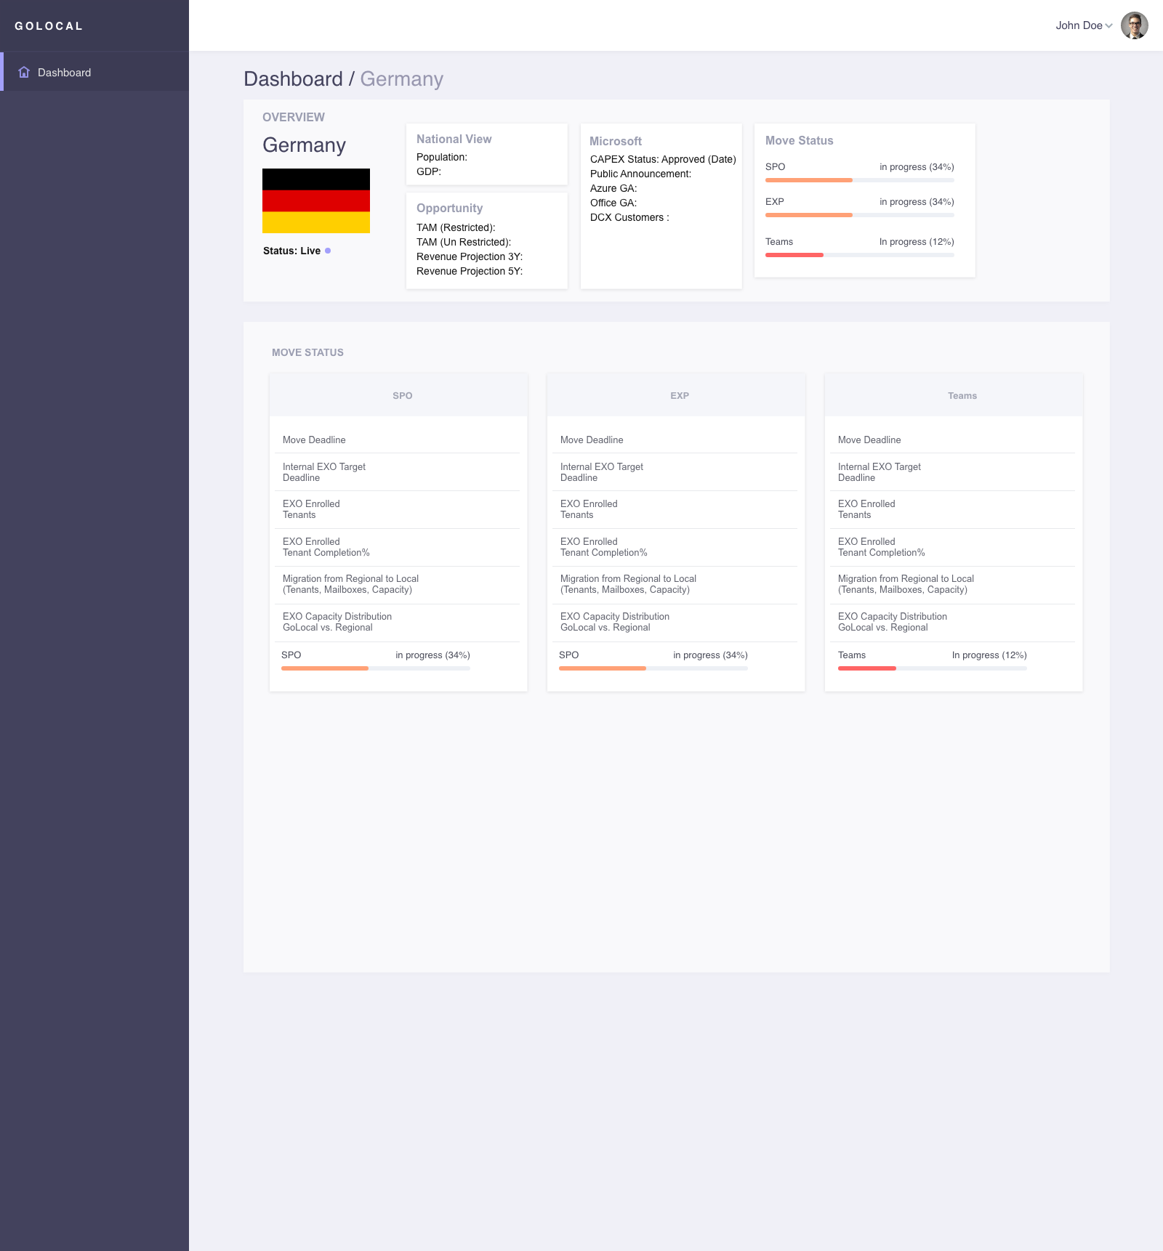
Pagination (React and material-ui)(MIT)
https://github.com/facebook/react
https://github.com/mui-org/material-ui
Progress (React and material-ui)(MIT)
https://github.com/facebook/react
https://github.com/mui-org/material-ui
Info Card (React and material-ui)(MIT)
https://github.com/facebook/react
https://github.com/mui-org/material-ui
Grid (React and material-ui)(MIT)
https://github.com/facebook/react
https://github.com/mui-org/material-ui
Progress (React and material-ui)(MIT)
https://github.com/facebook/react
https://github.com/mui-org/material-ui

Slide 3
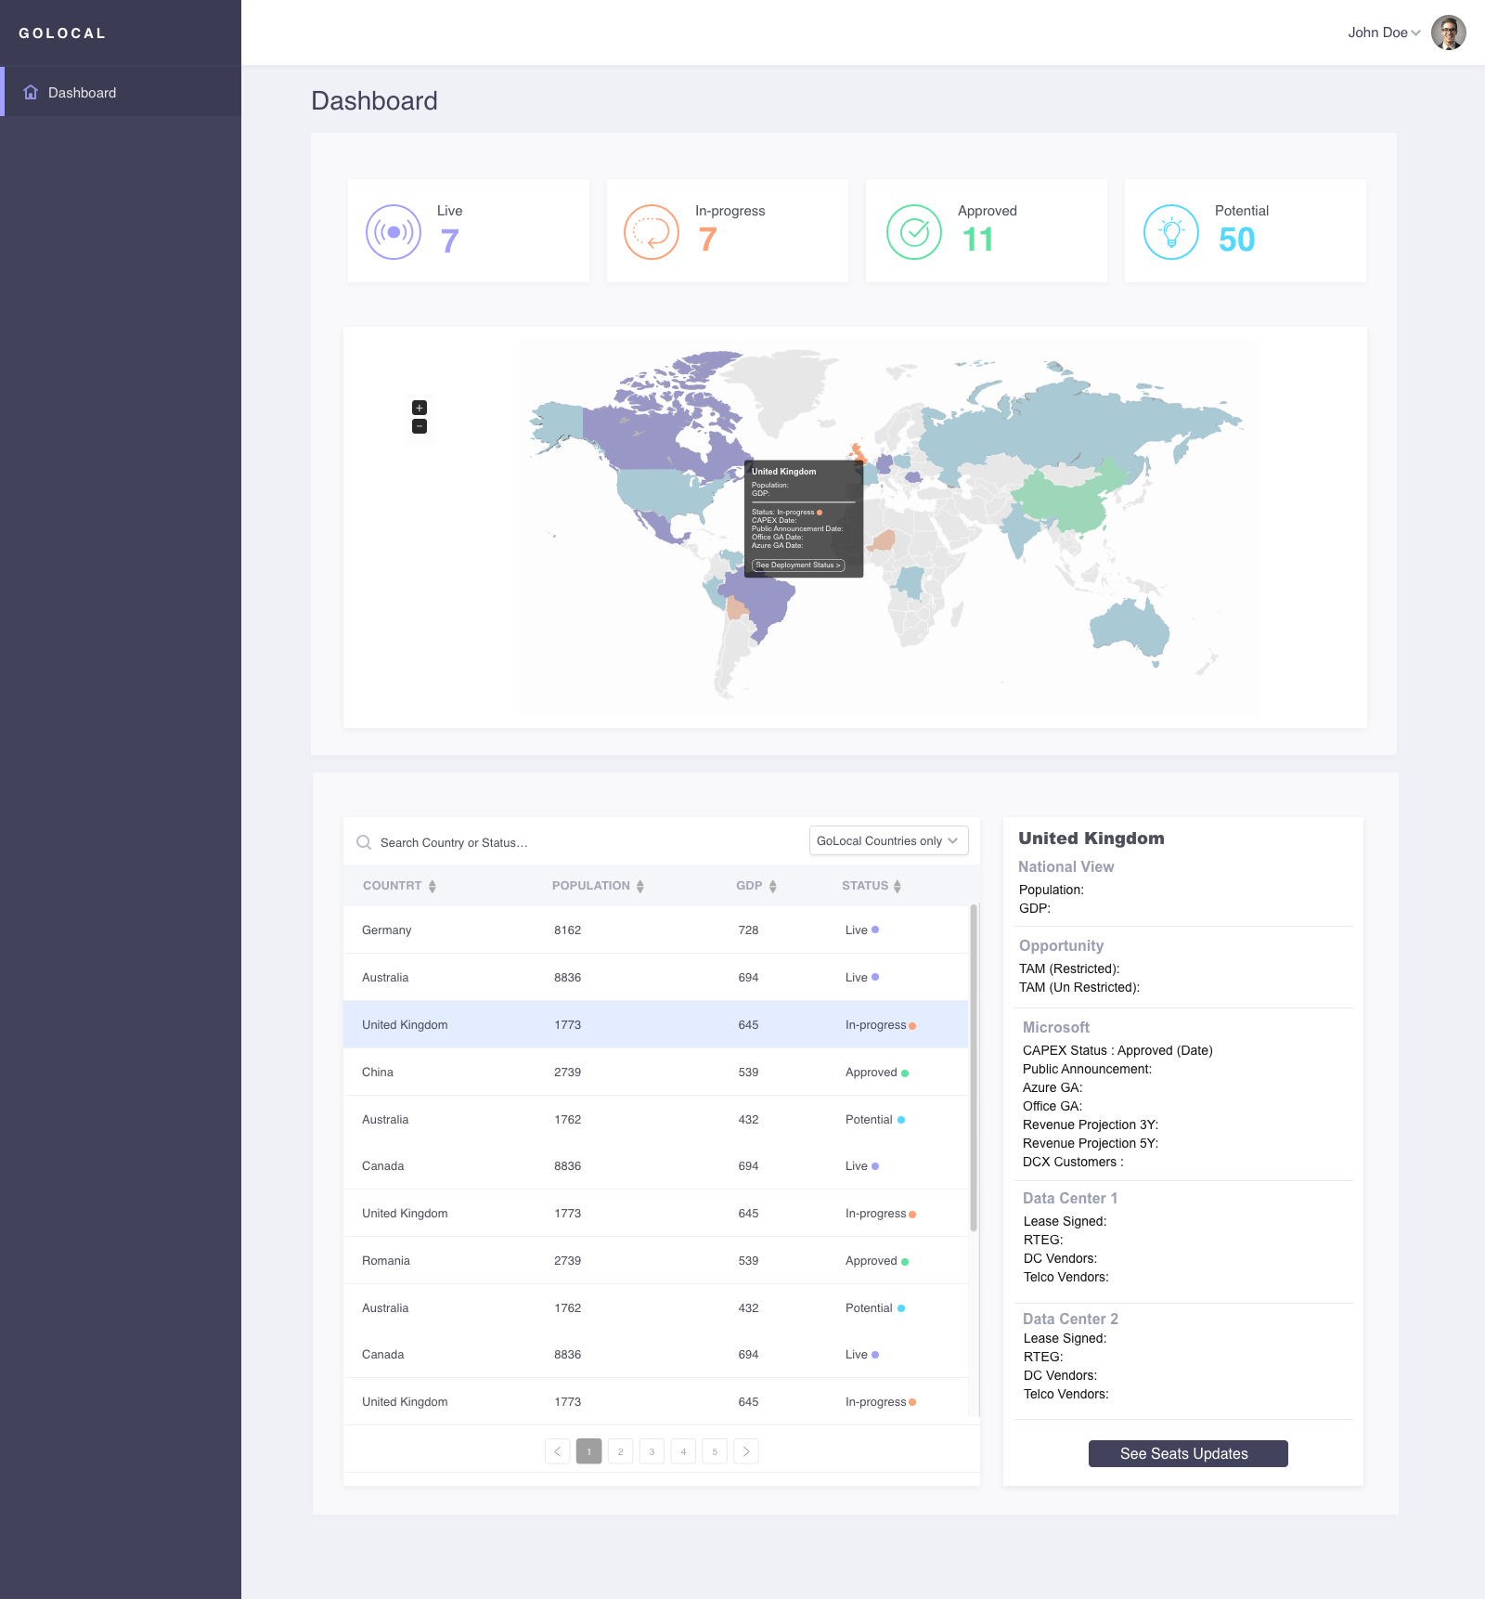

Slide 4
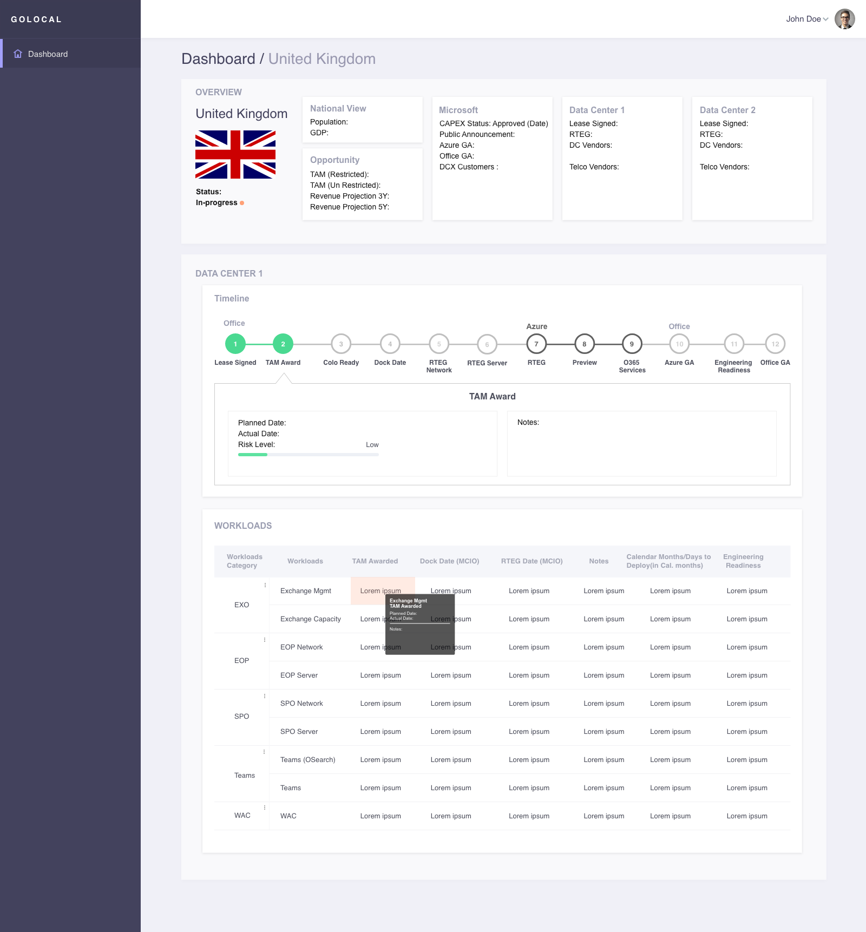
Grid And Info (React and material-ui)(MIT)
https://github.com/facebook/react
https://github.com/mui-org/material-ui
Timeline (React and material-ui)(MIT)
https://github.com/facebook/react
https://github.com/mui-org/material-ui
Grid (React and material-ui)(MIT)
https://github.com/facebook/react
https://github.com/mui-org/material-ui
Accordion (React and material-ui)(MIT)
https://github.com/facebook/react
https://github.com/mui-org/material-ui
Table (React and material-ui)(MIT)
https://github.com/facebook/react
https://github.com/mui-org/material-ui

Slide 5
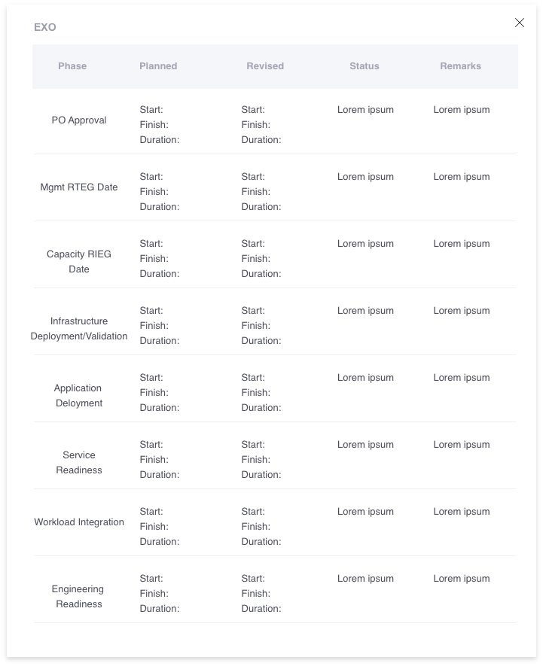
Table (React and material-ui)(MIT)
https://github.com/facebook/react
https://github.com/mui-org/material-ui
Table (React and material-ui)(MIT)
https://github.com/facebook/react
https://github.com/mui-org/material-ui

Slide 6
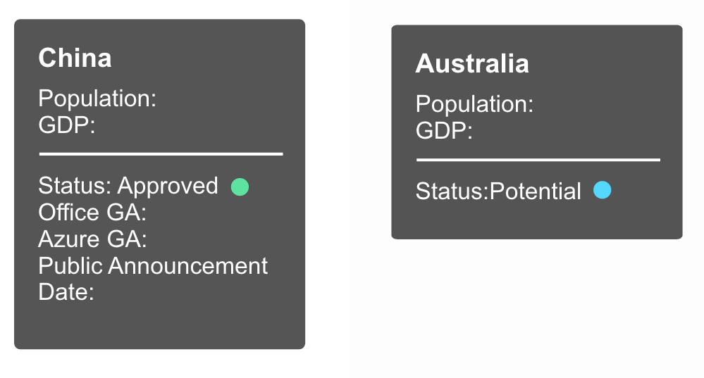
Wizard (React and material-ui)(MIT)
https://github.com/facebook/react
https://github.com/mui-org/material-ui
Approved country and Potential country pop-ups

Slide 7
High-Level Architecture
Node / React
User Interface
Controllers View Models
Domain Services
Application Core
Interfaces
Entities
Asp.Net Core
External Dependencies
Azure Tables
Azure AD
PowerBi ?
Asp.Net Core
Infrastructure
Repositories Impl Services

Slide 8
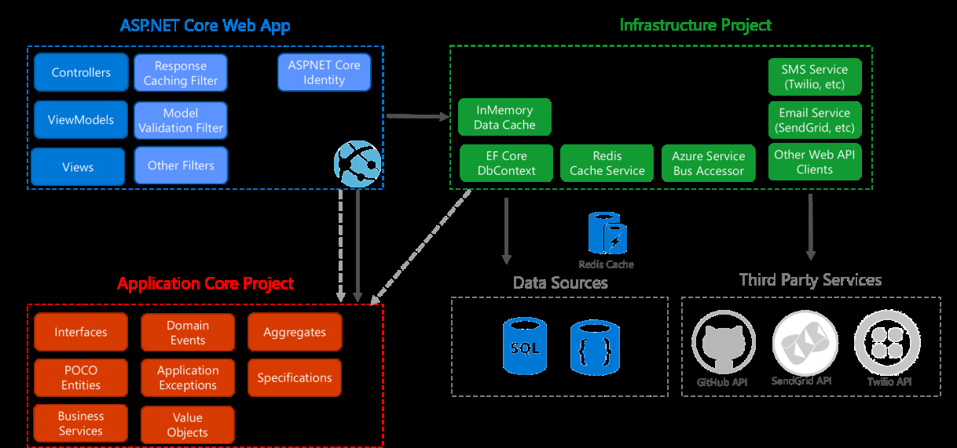
Architecture Detail
Client App
Data
Controllers
Domain
Pages
Entities
Services
Azure Table
Events
Interfaces

Slide 9
Architecture Layers
User Interface
Infrastructure
Tests
Application Core

